Slide 1
UNIT Title: Optimizing Patient Flow and Data Integrity Designer: DW
Purpose: close a specific performance gap among front-desk clinic staff by standardizing patient check-in procedures, thereby eliminating critical data entry errors and significantly reducing waiting room bottlenecksSeat-time:90 minutes
Template page 1
Context: The instruction leverages problem-centered case study analysis to activate existing knowledge, direct demonstration of a standardized 5-Step Protocol, high-fidelity paired role-play scenarios for hands-on application, and immediate corrective feedback via peer and facilitator assessment.
Target Audience: This unit is designed for newly hired healthcare administrators and front-desk clinic receptionists responsible for managing daily patient intake and operational flow. Prerequisite Knowledge & Skills: System Navigation: Basic computer literacy and fundamental experience navigating Electronic Health Record (EHR) systems, Regulatory Awareness: A baseline understanding of HIPAA privacy regulations regarding the handling of patient information. Interpersonal Basics: Foundational customer service skills for interacting with the public.
Expected UNIT outcomes: Upon completion of this instructional unit, learners will be able to: Execute the 5-Step Check-In Protocol (Acknowledge, Authenticate, Audit, Acquire, Advance) during a simulated patient intake with 100% accuracy, as measured by the standardized observation rubric, Resolve a missing or mismatched insurance entry in the simulated Electronic Health Record (EHR) system in under 3 minutes, Apply standardized, scripted de-escalation techniques during a role-play scenario to successfully guide a frustrated patient through the intake process without escalating the conflict.
Overview: This single-session, face-to-face facilitated workshop requires 1.5 hours (90 minutes) of seat-time, with all instruction and practice occurring exclusively during the live session and no prerequisite homework required. The instructional flow begins with a 15-minute introduction and activation phase, where learners analyze a real-world clinic bottleneck case study to establish the current performance gap and activate existing knowledge of front-desk errors. This is immediately followed by 20 minutes of content delivery, during which the facilitator models a flawless intake interaction by demonstrating the standardized 5-Step Check-In Protocol using a visual job aid and mock EHR screen. Learners then transition into a 35-minute hands-on application, practicing their procedural and soft skills in a high-fidelity setting through paired role-play simulations utilizing "Patient Persona Cards" and a sandboxed EHR environment. Afterward, a 10-minute assessment and feedback period provides immediate corrective and confirmation feedback as peers and the facilitator score the role-play using a 10-point observation rubric. The unit concludes with a 10-minute summary and reflection phase featuring a guided group debrief and the completion of a "Personal Action Plan," ensuring learners leave with a concrete strategy to integrate the new protocols into their next live clinic shift.

Slide 2
Template page 2
UNIT Title: Optimizing Patient Flow and Data Integrity Designer:DW
Purpose:close a specific performance gap among front-desk clinic staff by standardizing patient check-in procedures, thereby eliminating critical data entry errors and significantly reducing waiting room bottlenecks Seat-time: 90
Key UNIT content: The content covered in this unit centers on standardizing the patient check-in workflow to ensure 100% data accuracy and efficient operational flow. The primary focus is the "5-Step Check-In Protocol" (Acknowledge, Authenticate, Audit, Acquire, Advance). Additionally, the unit covers Electronic Health Record (EHR) data verification best practices (auditing demographics and insurance coverage to prevent downstream errors), scripted conflict de-escalation strategies for managing frustrated patients during bottlenecks, and the proper system procedures for executing seamless clinical handoffs to the medical team.
Content learning assessments: Quizzes: A formative verbal knowledge check (Q&A) conducted immediately after the content delivery to verify comprehension of the 5-Step Protocol and EHR data requirements. Assignments & Projects: The primary assessment is a performance-based assignment consisting of a high-fidelity paired role-play simulation where learners execute the check-in process using "Patient Persona Cards". Performance is evaluated by peers and the facilitator using a standardized 10-point Observation Rubric. Learners also complete a final reflection assignment in the form of a "Personal Action Plan" worksheet. Discussions: A guided, structured post-activity group debrief discussion assessing the learners' ability to troubleshoot complex anomalies and friction points encountered during the simulation.
Resources required for UNIT: This unit requires a mix of newly created and existing materials. Custom materials to be developed include a Facilitator Guide, a Learner Packet, a laminated 5-Step Protocol Job Aid, five Patient Persona Cards for the role-play activities, a Performance Observation Rubric, and a Personal Action Plan reflection worksheet. These will be supplemented by existing resources, including a HIPAA Compliance Reference Article, a clinic Insurance Provider Reference Directory, and an EHR Training Sandbox software environment. Required technology includes laptops or tablets for learner access to the sandbox, alongside a projector and screen for facilitator demonstrations.
Facilities required for UNIT: The instruction for this unit will take place in a dedicated healthcare classroom. The space features a primary facilitator station equipped with a projector and screen to allow for clear demonstrations of the 5-Step Protocol and mock EHR entries. Additionally, the room layout provides computer stations and adequate desk space for learners to use personal laptops while accessing the simulated Electronic Health Record (EHR) training sandbox. Finally, the facility has flexible seating and open floor area so learners can comfortably pair up and physically simulate front-desk interactions during the hands-on role-play exercises without overcrowding.

Slide 3
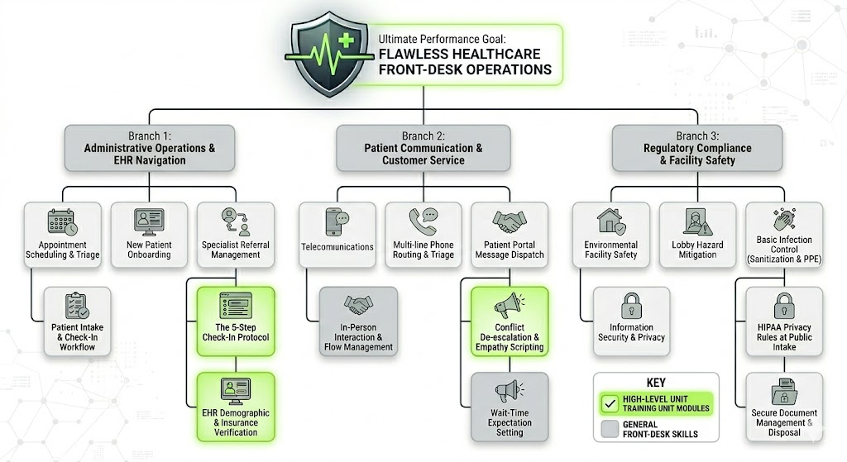
Template page 3
UNIT Title: Optimizing Patient Flow and Data Integrity Designer: DW
Purpose: close a specific performance gap among front-desk clinic staff by standardizing patient check-in procedures, thereby eliminating critical data entry errors and significantly reducing waiting room bottlenecks Seat-time: 90
Content Hierarchy: Shows overall performance and ALL key knowledge/skills required to be competent … highlight parts of hierarchy that will be covered in UNIT. Include at least 3 main branches and 3 levels for each branch.

Slide 4
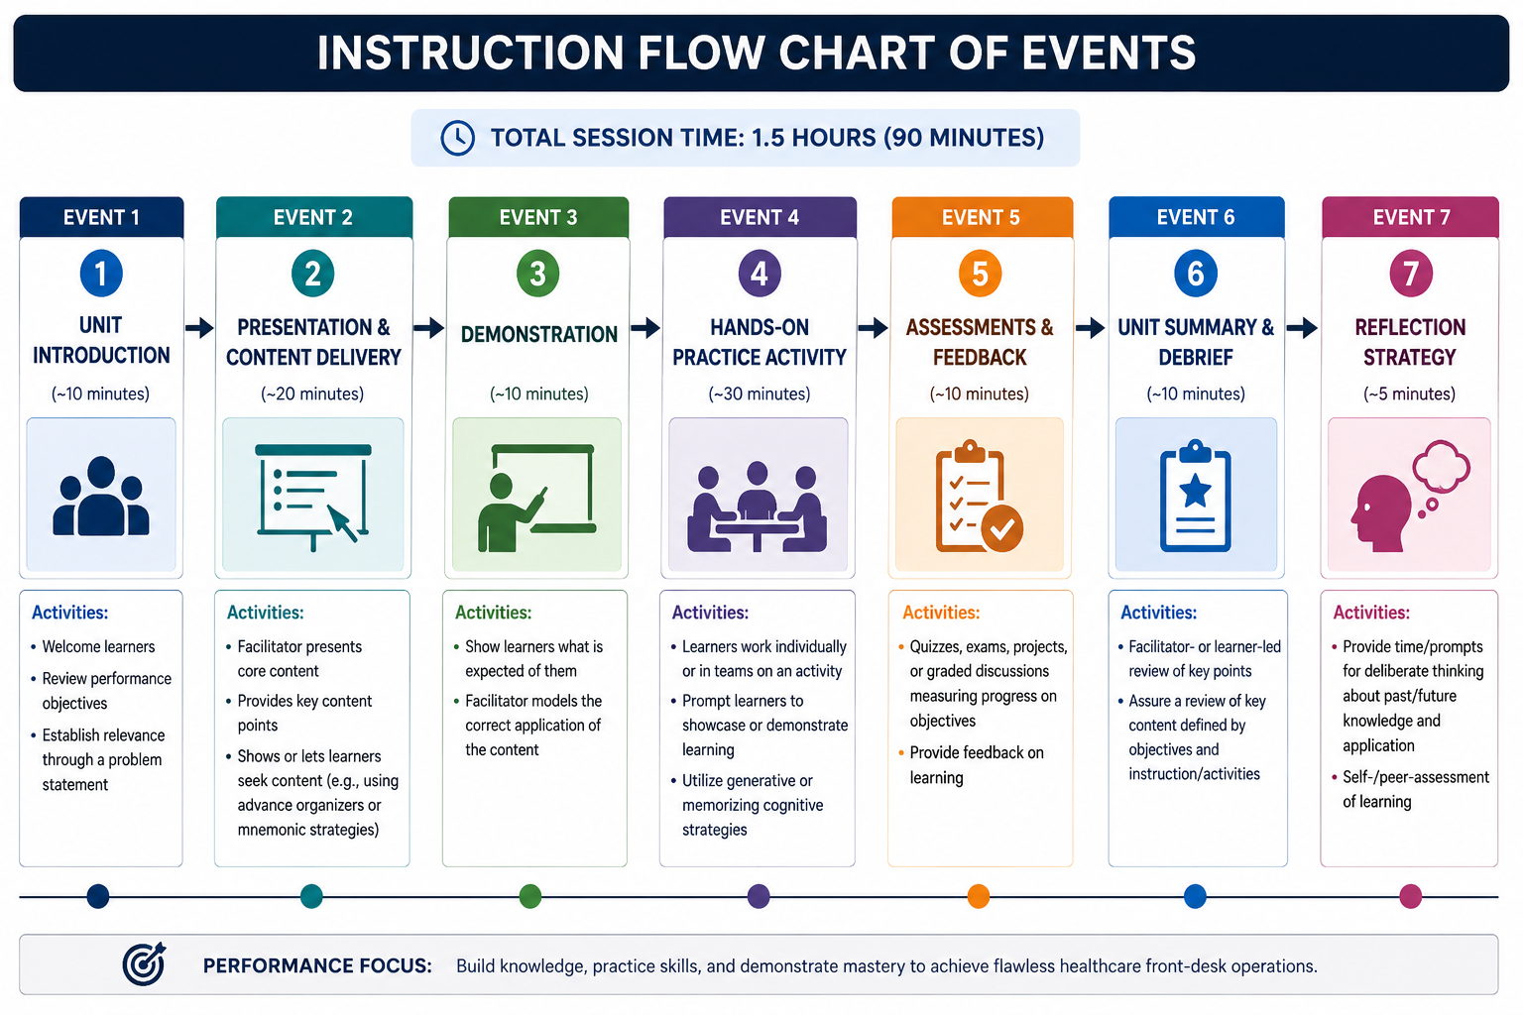
Template page 4
UNIT Title: Optimizing Patient Flow and Data Integrity Designer: DW
Purpose: close a specific performance gap among front-desk clinic staff by standardizing patient check-in procedures, thereby eliminating critical data entry errors and significantly reducing waiting room bottleneck Seat-time: 90 minutes
UNIT Flow Chart
of EVENTS:
Brief EVENT descriptions:
Event 1: Unit Introduction (~10 minutes)
Activities: Welcome learners, review performance objectives, and establish relevance through a problem statement.
Event 2: Presentation & Content Delivery (~20 minutes)
Activities: Facilitator presents core content, provides key content points, and shows or lets learners seek content
Event 3: Demonstration (~10 minutes)
Activities: Show learners what is expected of them, with the facilitator modeling the correct application of the content.
Event 4: Hands-on Practice Activity (~30 minutes)
Activities: Learners work individually or in teams on an activity, prompting them to showcase or demonstrate learning (e.g., utilizing generative or memorizing cognitive strategies).
Event 5: Assessments & Feedback (~10 minutes)
Activities: Quizzes, exams, projects, and graded discussions measuring progress on objectives, followed by feedback events on learning.
Event 6: Unit Summary & Debrief (~10 minutes)
Activities: Facilitator review of key points, assuring a review of key content defined by objectives and instruction/activities.
Event 7: Reflection Strategy (~5 minutes)
Activities: Provide time/prompts for deliberate thinking about past/future knowledge and application, and self-/peer-assessment of learning.

Slide 5
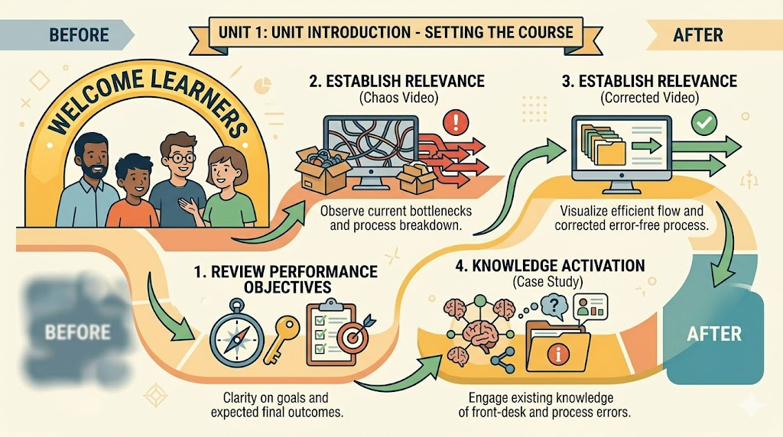
Storyboard Template
UNIT title: Optimizing Patient Flow and Data Integrity EVENT Title: Unit Introduction Estimated Time for EVENT: 10 minutes
EVENT – Representative image | EVENT Description: The "Unit Introduction" event begins with the facilitator welcoming the learners and providing a clear overview of the unit's core performance objectives. To establish immediate, real-world relevance, the facilitator presents two contrasting instructional videos. The first video illustrates the chaos, patient frustration, and bottlenecking that occurs when front-desk processes fail or data is entered incorrectly. The second video immediately follows, demonstrating the ideal, streamlined workflow and showcasing how smoothly operations run when all pertinent errors are corrected using standard procedures. Following these visual examples, the facilitator transitions into a knowledge activation phase by presenting a real-world clinic bottleneck case study. Learners are prompted to discuss the case and share their own experiences with intake errors, effectively highlighting the current performance gap and securing their buy-in for the upcoming training.
 | EVENT Deliverables: During this event, the primary tangible deliverables are the distributed Learner Packets, which provide participants with the unit overview, written performance objectives, and the printed text of the real-world clinic bottleneck case study. Additionally, this phase produces initial learner-generated notes and documented group observations captured during the comparative analysis of the "chaos versus ideal" videos and the ensuing group discussion.
 | EVENT-required resources: Facilitator: Facilitator guide, a computer workstation, a projector, a viewing screen, and audio speakers for video playback. Two prepared video files. Learner Materials: Printed Learner Packets and writing utensils.
Clarifying Notes on EVENT: The facilitator must ensure the transition between the "chaos" video and the "ideal workflow" video is seamless to maximize the visual contrast between a broken process and a successful one. During the case study discussion, the facilitator should act as a guide rather than a lecturer, intentionally prompting learners to share their own personal experiences with front-desk errors to successfully activate prior knowledge. | EVENT primary and sub-learning objectives: Primary Objective: Learners will be able to articulate the overarching goals of the unit and recognize the critical impact that accurate front-desk operations have on overall clinic efficiency and patient care. Learners will be able to identify specific operational bottlenecks and patient frustrations caused by front-desk data errors.
 | EVENT primary content points: Introduction to the training goals, expected final outcomes, and the critical role the front desk plays in overall clinic success.
NOTE: Complete one template page for EACH event on the UNIT Flow chart. Be sure that objectives, content, assessments, strategies, and time align with information in earlier templates. Walking through storyboard should provide a clear picture of how the instructional unit will work.

Slide 6
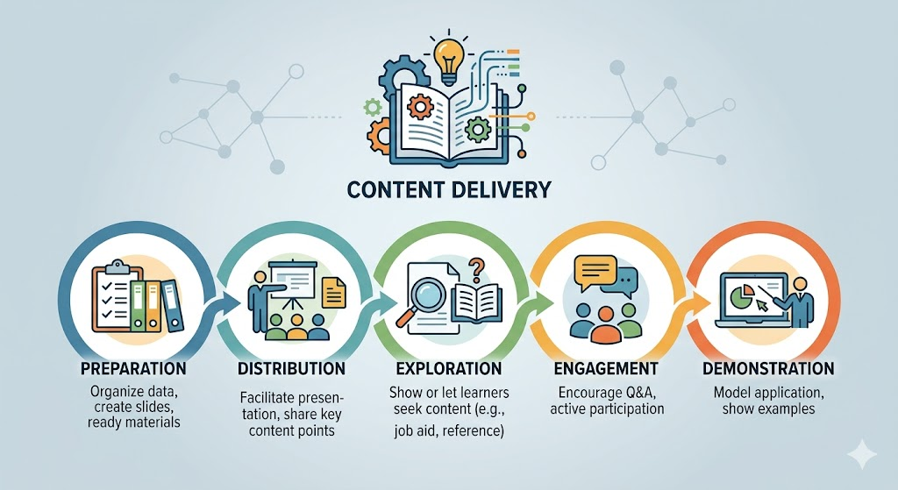
Storyboard Template
UNIT title: Optimizing Patient Flow and Data Integrity EVENT Title: Presentation & Content Delivery Estimated Time for EVENT: 20 minutes
EVENT – Representative image | EVENT Description: The "Presentation & Content Delivery" event begins with the facilitator introducing the core knowledge required to close the front-desk performance gap. The facilitator presents the standardized "5-Step Check-In Protocol" (Acknowledge, Authenticate, Audit, Acquire, Advance) using a visual slide deck. As the facilitator walks the group through each phase of the protocol, they distribute and reference a laminated 5-Step Protocol Job Aid, which serves as a cognitive strategy tool for the learners to use on the job. During this 20-minute session, the facilitator specifically highlights critical checkpoints for Electronic Health Record (EHR) demographic and insurance verification to prevent downstream billing errors. Additionally, the presentation covers scripted communication techniques for conflict de-escalation and setting accurate wait-time expectations, encouraging brief, active Q&A from the learners to ensure foundational understanding before moving into the demonstration phase.
 | EVENT Deliverables: the primary tangible items produced are the learners' annotated Learner Packets, containing their personal notes and highlights regarding the EHR verification checkpoints and scripted de-escalation strategies.
 | EVENT-required resources: Facilitator: Facilitator Guide, visual Presentation Slide Deck, computer, projector, and screen. Learners: Printed Learner Packets, the laminated 5-Step Protocol Job Aids, and pens or highlighters.
Clarifying Notes on EVENT: This presentation should not be a passive lecture; the facilitator must actively connect the 5-Step Protocol back to the bottleneck case study discussed in Event 1 to maintain high learner relevance. The facilitator should not simply hand out the 5-Step Protocol Job Aid to be put aside; they must explicitly direct learners to look at the job aid and follow along as each step is presented on the screen. | EVENT primary and sub-learning objectives:Primary Objective: Learners will comprehend the standardized 5-Step Check-In Protocol and its critical role in eliminating data errors and clinic bottlenecks. Sub-Learning Objectives: * Learners will be able to accurately identify and sequence the five phases of the check-in protocol
 | EVENT primary content points: The 5-Step Check-In Protocol: Detailed breakdown of the five standardized phases: Acknowledge, Authenticate, Audit, Acquire, and Advance.
NOTE: Complete one template page for EACH event on the UNIT Flow chart. Be sure that objectives, content, assessments, strategies, and time align with information in earlier templates. Walking through storyboard should provide a clear picture of how the instructional unit will work.

Slide 7
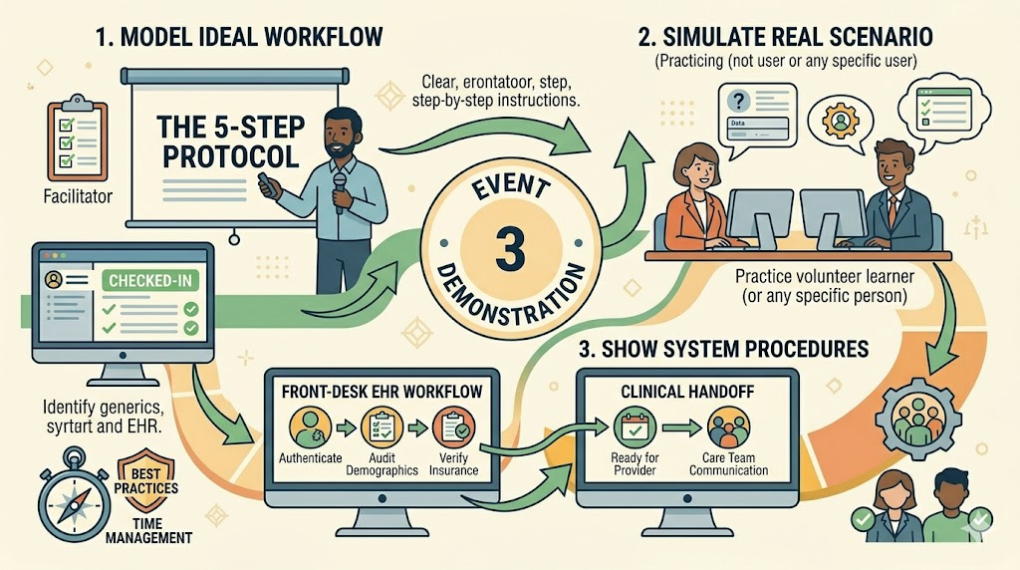
Storyboard Template
UNIT title: Optimizing Patient Flow and Data Integrity EVENT Title: Demonstration Estimated Time for EVENT: 10 minutes
EVENT – Representative image | EVENT Description: The "Demonstration" event transitions learners from theory to practical application as the facilitator models a flawless execution of the 5-Step Check-In Protocol. Using the simulated Electronic Health Record (EHR) training sandbox projected onto the main screen, the facilitator role-plays a realistic clinic check-in scenario, either solo or with a volunteer. During this live demonstration, the facilitator explicitly shows the correct application of each protocol step, proper system navigation for accurate demographic and insurance data entry, and the appropriate professional tone required for patient interactions. This active modeling ensures learners clearly understand the behavioral and technical expectations, providing a concrete example of success before they move into their own hands-on practice sessions.
 | EVENT Deliverables: a completed mock patient check-in record generated within the EHR training sandbox, targeted learner observation notes, with participants specifically capturing the facilitator’s system navigation pathways, clicking sequences, and exact vocal phrasing used during the modeled patient interaction.
 | EVENT-required resources: Facilitator Guide, visual Presentation Slide Deck, computer, projector, and screen. Learners: Printed Learner Packets, the laminated 5-Step Protocol Job Aids, and pens or highlighters.
Clarifying Notes on EVENT: The facilitator must explicitly announce which of the 5 steps they are currently modeling (e.g., "I am now moving from Authenticate to Audit") so learners can accurately follow along on their printed Job Aids. Ensure the EHR sandbox projection is scaled appropriately so that all learners in the room can clearly see the specific cursor movements, buttons, and navigation pathways being utilized. Facilitator must provide them with a pre-scripted "Patient Persona" to ensure the demonstration remains focused on the primary learning objectives and does not derail into an overly complex edge-case scenario. When demonstrating the de-escalation scripts, the facilitator must place heavy emphasis on modeling a calm, professional vocal tone and measured pacing, explicitly explaining to the learners why that tone is effective in preventing further patient frustration. | EVENT primary and sub-learning objectives: Primary Objective: Learners will be able to connect the theoretical 5-Step Check-In Protocol to its practical, real-time application within the Electronic Health Record (EHR) system. Sub-Learning Objectives: * Learners will be able to identify the correct EHR system navigation pathways and clicking sequences required to verify demographic and insurance data.
 | EVENT primary content points: Real-Time 5-Step Protocol Execution, EHR System Navigation, and Applied De-escalation Scripts
NOTE: Complete one template page for EACH event on the UNIT Flow chart. Be sure that objectives, content, assessments, strategies, and time align with information in earlier templates. Walking through storyboard should provide a clear picture of how the instructional unit will work.

Slide 8
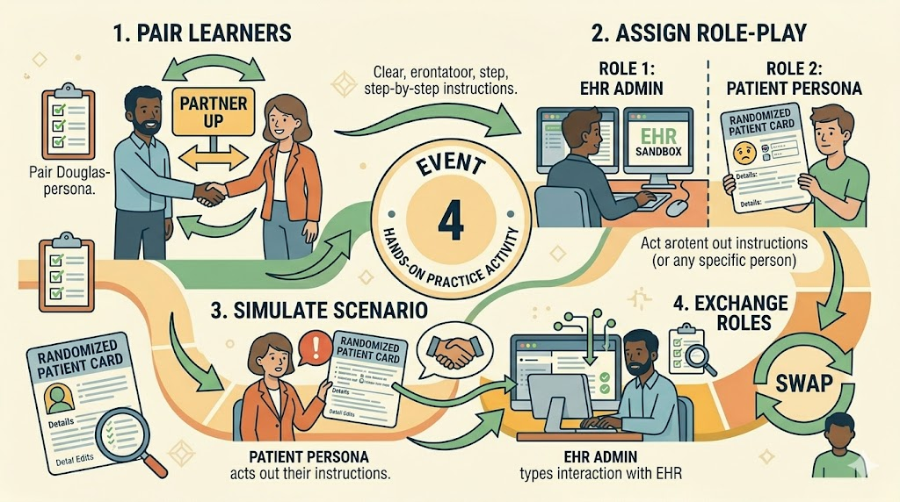
Storyboard Template
UNIT title: Optimizing Patient Flow and Data Integrity EVENT Title: Hands on Practice Activity Estimated Time for EVENT: 30 minutes
EVENT – Representative image | EVENT Description: The "Hands-On Practice Activity" event immerses learners in a high-fidelity, controlled simulation where they actively apply the newly learned check-in procedures. Learners are divided into pairs, with one participant acting as the front-desk administrator operating the live Electronic Health Record (EHR) training sandbox, and the other assuming the role of the patient. The "patient" is provided with randomized "Patient Persona Cards" that include specific, complex scenario injects—such as mismatched insurance information or a highly frustrated demeanor. The acting administrator must seamlessly execute the 5-Step Protocol (Acknowledge, Authenticate, Audit, Acquire, Advance), accurately navigate the EHR software to verify data, and utilize the appropriate scripted de-escalation techniques. Once a scenario is completed, the learners swap roles, ensuring each participant receives direct, hands-on practice in both navigating the technical system and managing complex interpersonal interactions.
 | EVENT Deliverables: the primary tangible deliverables are the completed mock patient check-in records successfully processed and saved within the live EHR training sandbox. Additionally, this event produces the completed Performance Observation Rubrics, which are actively filled out by the observing peer partner to document the acting administrator's accuracy in executing the 5-Step Protocol, navigating the software, and utilizing appropriate de-escalation techniques.
 | EVENT-required resources: Facilitator: Facilitator Guide, a timer or stopwatch to keep role-play rounds on track, and a clipboard with master observation checklists for roaming assessment. For Learners: Computer workstations with active login credentials for the live Electronic Health Record (EHR) training sandbox, sets of printed, randomized "Patient Persona Cards" for the simulation injects, printed Performance Observation Rubrics for peer evaluations, and their laminated 5-Step Protocol Job Aids for active reference.
Clarifying Notes on EVENT: Strict time management is crucial; the facilitator must use a timer to ensure each role-play round concludes on schedule and that both learners have an equal opportunity to practice as the administrator. The facilitator must actively roam the room during the activity, rather than observing from the front, to listen to the learners' vocal tones and monitor their EHR screen navigation in real-time. Emphasize to the learners that the peer feedback phase should be constructive and directly tied to the Performance Observation Rubric, avoiding subjective or overly critical comments. Ensure the EHR training sandbox is configured to easily "reset" between rounds, or ensure enough distinct patient profiles are available so that the second learner in the pair does not simply repeat the exact same scenario with the exact same data. | EVENT primary and sub-learning objectives: Primary Objective: Learners will be able to accurately and efficiently apply the 5-Step Check-In Protocol and de-escalation strategies within a simulated, real-time electronic health record (EHR) environment to process complex patient intakes. Sub-Learning Objectives: Learners will be able to seamlessly execute all five phases of the protocol (Acknowledge, Authenticate, Audit, Acquire, Advance) without omitting critical data verification steps.
 | EVENT primary content points: Application of the 5-Step Protocol, EHR Data Verification & Navigation, Conflict De-escalation & Communication, and eer Observation & Assessment
NOTE: Complete one template page for EACH event on the UNIT Flow chart. Be sure that objectives, content, assessments, strategies, and time align with information in earlier templates. Walking through storyboard should provide a clear picture of how the instructional unit will work.

Slide 9
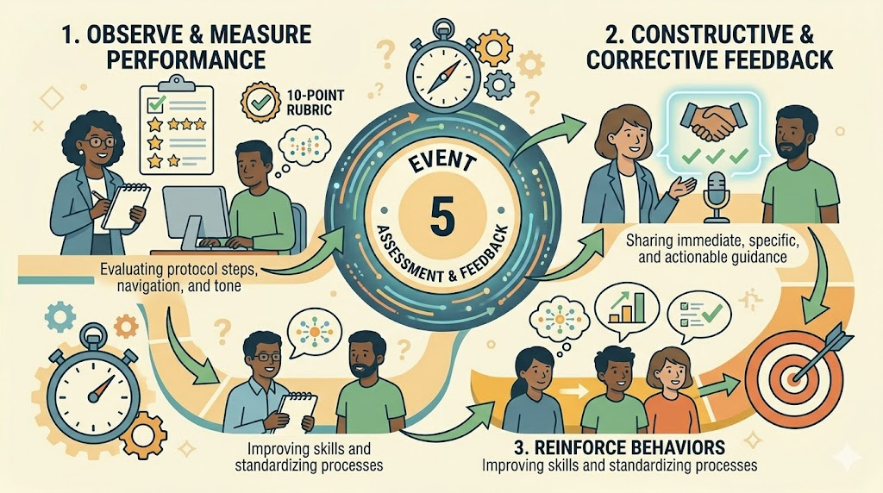
Storyboard Template
UNIT title: Optimizing Patient Flow and Data Integrity EVENT Title: Assessments and Feedback Estimated Time for EVENT: 10 minutes
EVENT – Representative image | EVENT Description: The "Assessment and Feedback" event directly follows the hands-on practice and is designed to measure learner progress while providing immediate, actionable guidance. During this phase, the observing peer partner and the roaming facilitator utilize a standardized 10-point Performance Observation Rubric to critically evaluate the acting administrator's accuracy in executing the 5-Step Protocol, navigating the EHR system, and maintaining an appropriate communication tone. Immediately following each role-play round, the observer delivers constructive, corrective feedback to their partner. This structured debrief ensures that learners receive direct, real-time insights to reinforce desired behaviors and refine their technical and interpersonal skills before transitioning into the final unit summary and reflection.
 | EVENT Deliverables: the primary tangible deliverables are the fully completed 10-point Performance Observation Rubrics. These rubrics serve as documented records of the acting administrator's scores and include specific qualitative notes regarding their 5-Step Protocol accuracy, EHR system navigation, and communication tone. A secondary deliverable is the actionable, written feedback documented by the peer observer and the facilitator, which learners will retain in their packets as a personalized reference guide for continuous performance improvement on the job.
 | EVENT-required resources: Facilitator: Facilitator Guide, a clipboard with master copies of the 10-point Performance Observation Rubric, and a timer to ensure the debrief and feedback sessions remain on schedule. Learners: Printed copies of the 10-point Performance Observation Rubric, the completed mock patient check-in records generated in the EHR sandbox, their Learner Packets, and writing utensils.
Clarifying Notes on EVENT: The facilitator must actively monitor the peer feedback exchange to ensure comments remain strictly tied to the observable behaviors outlined in the 10-point Performance Observation Rubric, actively redirecting any subjective or overly critical personal opinions. It is critical to maintain a psychologically safe environment; the facilitator should be prepared to step in and mediate if a feedback session becomes unproductive or if a learner becomes defensive. Instruct the observers to focus their feedback on actionable takeaways, such as specific EHR system clicks missed or exact phrasing adjustments for de-escalation, rather than simply handing over the numerical score. The facilitator must strictly manage the clock during this debrief phase to ensure both learners in the pair have adequate, equal time to give and receive their feedback before moving into the final unit wrap-up. | EVENT primary and sub-learning objectives: Primary Objective: Learners will be able to utilize a standardized observation rubric to evaluate peer performance and deliver actionable, constructive feedback to improve the execution of the 5-Step Check-In Protocol. Sub-Learning Objectives: * Learners will be able to accurately apply the 10-point Performance Observation Rubric to assess a peer's adherence to the protocol, EHR system navigation, and communication skills.
 | EVENT primary content points: Performance Evaluation, Technical and Behavioral Assessment, Corrective Feedback Delivery and Feedback Reception and Reflection.
NOTE: Complete one template page for EACH event on the UNIT Flow chart. Be sure that objectives, content, assessments, strategies, and time align with information in earlier templates. Walking through storyboard should provide a clear picture of how the instructional unit will work.

Slide 10
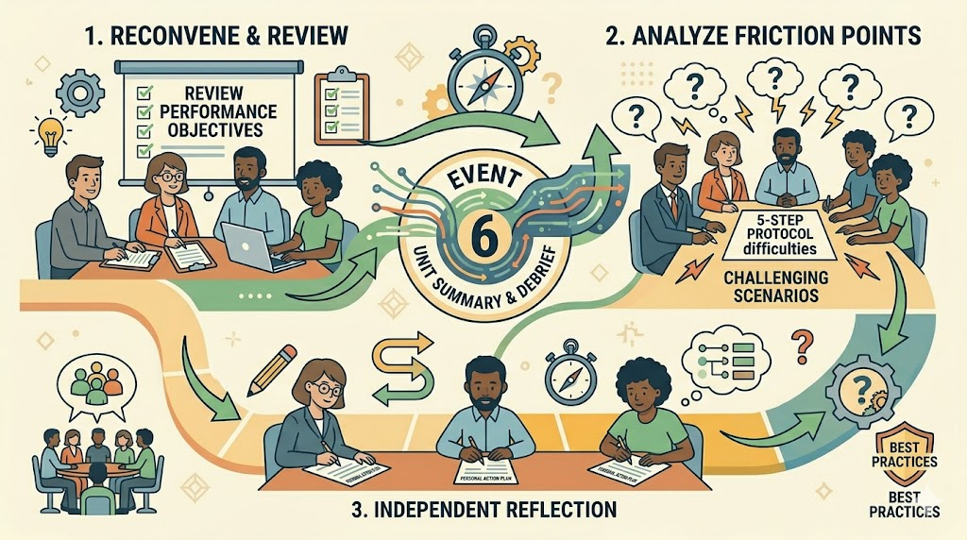
Storyboard Template
UNIT title: Optimizing Patient Flow and Data Integrity EVENT Title: Unit Summary & Debrief Estimated Time for EVENT: 10 minutes
EVENT – Representative image | EVENT Description:The "Unit Summary and Debrief" event serves as the consolidated conclusion and reflection phase for the training. The facilitator reconvenes the group to review the core learning objectives and lead a guided discussion addressing the key friction points and challenges discovered during the hands-on simulations. Following this collaborative debrief, the process transitions into a formal, independent reflection strategy. Learners complete a Personal Action Plan worksheet, prompting them to critically evaluate their performance and document specific, actionable steps for integrating the 5-Step Protocol and job aids into their actual clinic workflows. This ensures participants leave the session with a concrete strategy for real-world application during their upcoming live shifts.
 | EVENT Deliverables: completed Personal Action Plan worksheet for each learner, and Facilitator's Debrief Notes.
 | EVENT-required resources: Facilitator: Facilitator Guide, projector and screen or whiteboard/flipchart, and a timer to manage time for the group discussion and independent reflection. Learners: Learners' previously distributed Learner Packets, specifically the Personal Action Plan worksheet, and writing utensils.
Clarifying Notes on EVENT: The facilitator must strictly manage the clock to ensure the session does not run long during the group discussion; the independent reflection and completion of the Personal Action Plan are critical for the transfer of learning and must not be rushed as an afterthought. During the group debrief, the facilitator should intentionally foster a blame-free environment, actively encouraging learners to share where they struggled or felt flustered during the simulations so the group can collectively problem-solve. Emphasize to the learners that the Personal Action Plan is a practical, living document designed for their own use on the job, rather than a graded assignment to be collected by the instructor. The facilitator should be prepared with guiding questions (e.g., "Where will you physically place your job aid at your workstation?" or "How will you remind yourself to pause before responding to a frustrated patient?") in case learners struggle to identify concrete action steps during their independent reflection. | EVENT primary and sub-learning objectives: Primary Objective: Learners will be able to synthesize the feedback and experiences gathered from the practical simulations to formulate a concrete, personalized strategy for integrating the 5-Step Check-In Protocol into their daily clinical workflows. Sub-Learning Objectives: * Learners will be able to analyze and discuss common friction points encountered during the simulation to collaboratively identify best practices for overcoming real-world patient intake challenges.
 | EVENT primary content points: Objective Review & Group Debrief, Analysis of Real-World Application, Independent Reflection, and Personal Action Plan Completion
NOTE: Complete one template page for EACH event on the UNIT Flow chart. Be sure that objectives, content, assessments, strategies, and time align with information in earlier templates. Walking through storyboard should provide a clear picture of how the instructional unit will work.

Slide 11
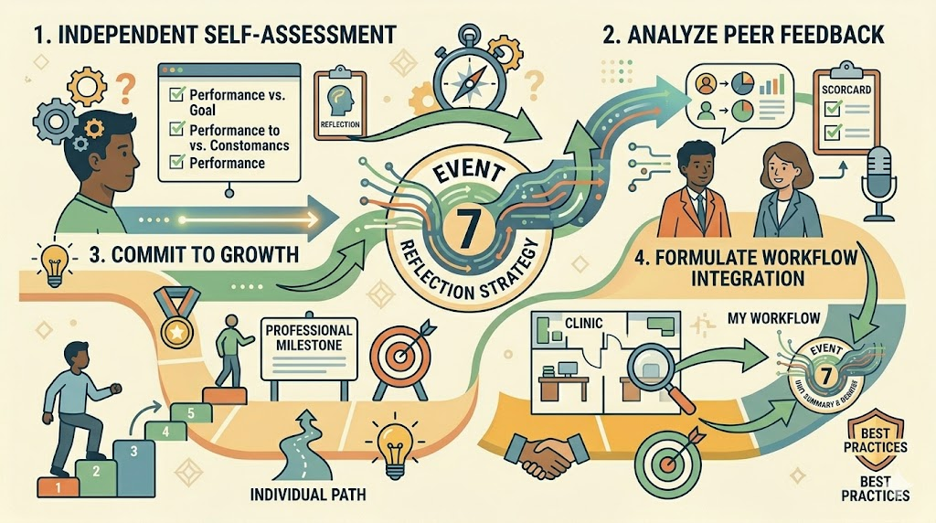
Storyboard Template
UNIT title: Optimizing Patient Flow and Data Integrity EVENT Title: Reflection Strategy Estimated Time for EVENT: 5 minutes
EVENT – Representative image | EVENT Description: The "Reflection Strategy" event is the final, individual phase of the instructional unit where learners transition from collaborative group debriefing to personal application. During this segment, learners independently engage in self-assessment to evaluate their performance against the unit's core objectives. They complete a Personal Action Plan worksheet, which serves as a cognitive bridge between the simulated training environment and their actual clinic workspace. This structured activity prompts learners to document explicit, actionable commitments on how they will physically and procedurally integrate the newly mastered 5-Step Protocol and corresponding job aids into their daily workflows, ensuring a direct transfer of skills to their real-world administrative duties.
 | EVENT Deliverables: Completed Personal Action Plan, Final Self-Assessment, and Instructional Feedback Form
 | EVENT-required resources: Facilitator: Facilitator Guide, and a timing device to ensure the individual reflection remains within the allotted 5-minute timeframe. Learners: Their individual Learner Packets, writing utensils, and access to their previously completed materials from the session, such as the 5-Step Protocol Job Aid and the Performance Observation Rubrics from Event 5, to serve as references during their self-assessment.
Clarifying Notes on EVENT: The facilitator should ensure the room remains quiet and focused during these final five minutes to allow learners the mental space required for meaningful individual reflection. While this is an independent activity, the facilitator should circulate silently to address any one-on-one questions regarding unique clinic-specific workflows or technical hurdles that may not have been covered in the group debrief. Explicitly state that the Personal Action Plan is a "take-away" tool for the learner's professional benefit and will not be collected, which fosters more honest and critical self-evaluation. Encourage learners to identify a specific "day-one" goal, one simple, high-impact change they can implement during their very next shift to gain immediate momentum with the new protocol. Remind learners that this document bridges the gap between the classroom and the clinic; the more specific they are about their physical workspace (e.g., "placing the job aid under my keyboard gel pad"), the higher the rate of long-term skill retention. | EVENT primary and sub-learning objectives: Primary Objective: Learners will develop a concrete, individual plan to ensure the consistent application and long-term retention of the 5-Step Check-In Protocol within their specific workplace environments. Sub-Learning Objectives: * Learners will be able to self-diagnose their individual proficiency and identify one specific technical or communication skill from the unit to prioritize for immediate improvement.
 | EVENT primary content points: Individual Self-Assessment, Synthesis of Feedback, Identification of Skill Gaps, Action Plan Development, and Commitment to Performance
NOTE: Complete one template page for EACH event on the UNIT Flow chart. Be sure that objectives, content, assessments, strategies, and time align with information in earlier templates. Walking through storyboard should provide a clear picture of how the instructional unit will work.

